Slide 1
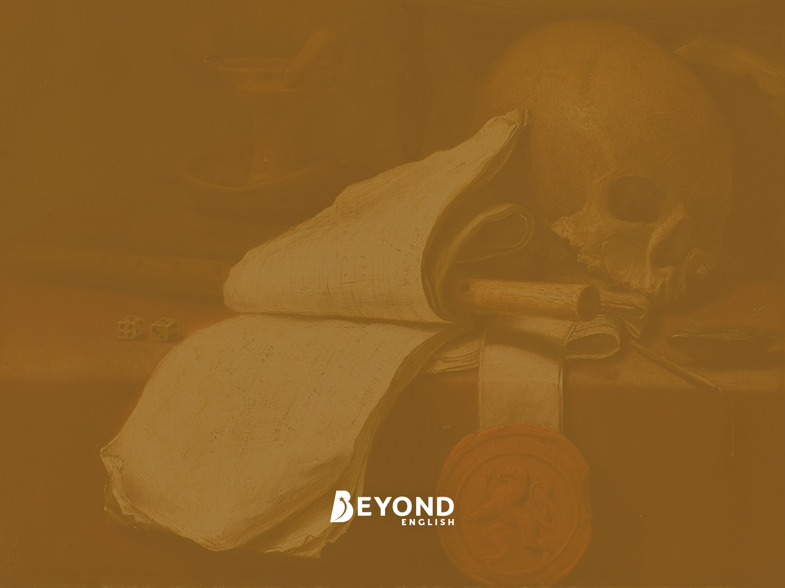
KS3 - Hamlet
Lesson 1: Introduction

Slide 2
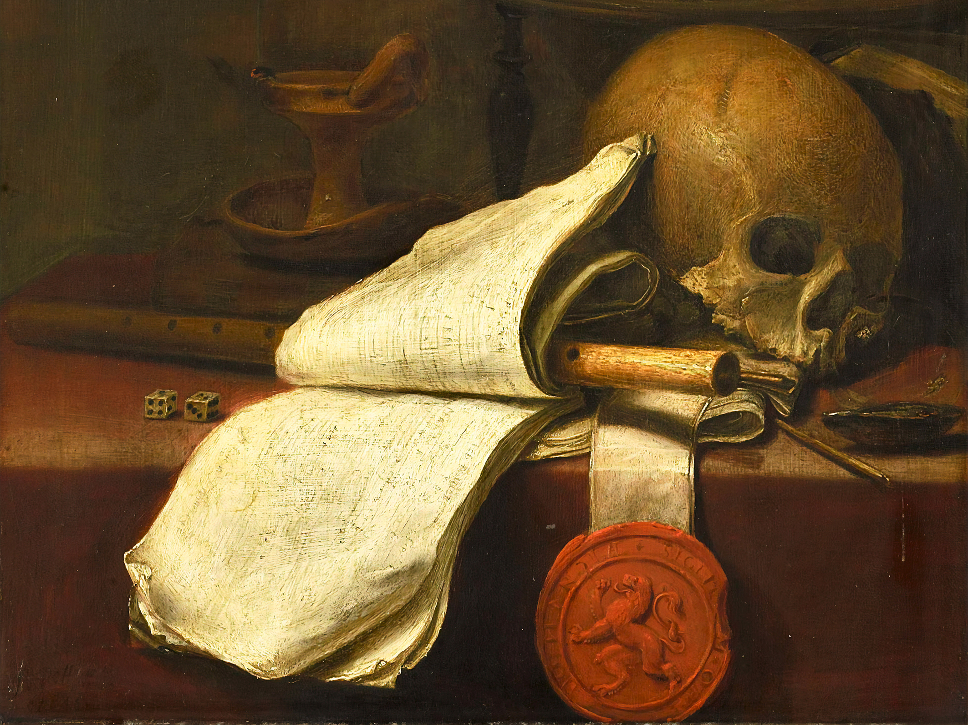
Learning Objective
To gain an initial understanding of context, character and plot in Shakespeare’s Hamlet.
Success Criteria
To develop an understanding of the King’s rules in the era in which the play is set and consider how they are linked to the play.
To show an understanding of plot in chronological order.
To show an understanding of the relationships between the characters in the play.

Slide 3
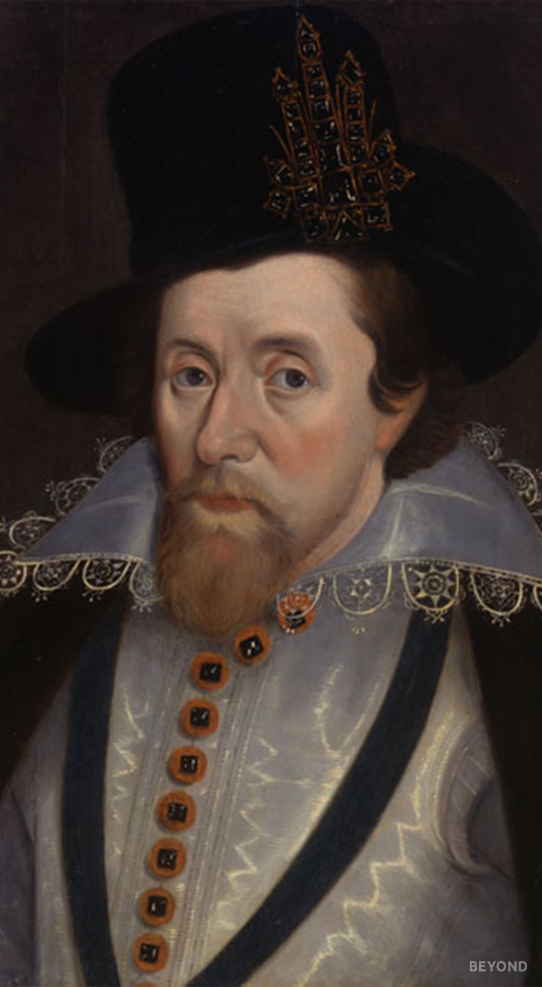
A King’s Rule Book
Hamlet was written in 1609 during the reign of King James I. At this time there were many rules that determined how the monarch should be treated by their subjects and how subjects within a kingdom should act in general.
Take a look at the rules below and see if you can work out which were true and which were false:
Kings are appointed by God.
Subjects are allowed to speak negatively about the King and face no consequences.
Honour is the most important value.
The act of murder is a punishable crime, even if you are seeking revenge for the murder of your parents.
The mourning period for a King is six months to a year.

Slide 4
A King’s Rule Book
Kings are appointed by God – TRUE
It was believed during this time that every person had their place in the world. This was called The Chain of Being, where God and religion were uppermost with everything else below. A king was the next important being on the list. It was believed that God had control of who was king (known as The Divine Right of Kings), and if you were to murder that King then the act would be punishable by God.
Subjects are allowed to speak negatively about the King and face no consequences - FALSE
This was considered as treason and was punishable by death.
Honour is the most important value - TRUE
The act of murder is a punishable crime, even if you are seeking revenge for the murder of your parents – FALSE
Getting revenge for the death of your parents was considered an exception to the law.
The mourning period for a King is six months to a year – TRUE
Although often a king’s widow would remarry in the first year! During the time the play was written, however, grief was actually considered a weakness and a lack of respect for God, therefore any display of grief was heavily frowned upon.

Slide 5
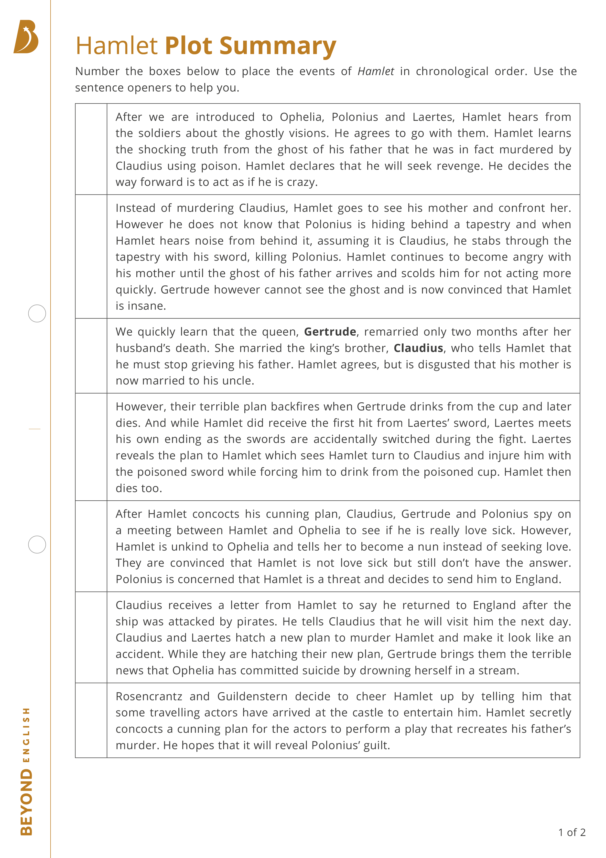
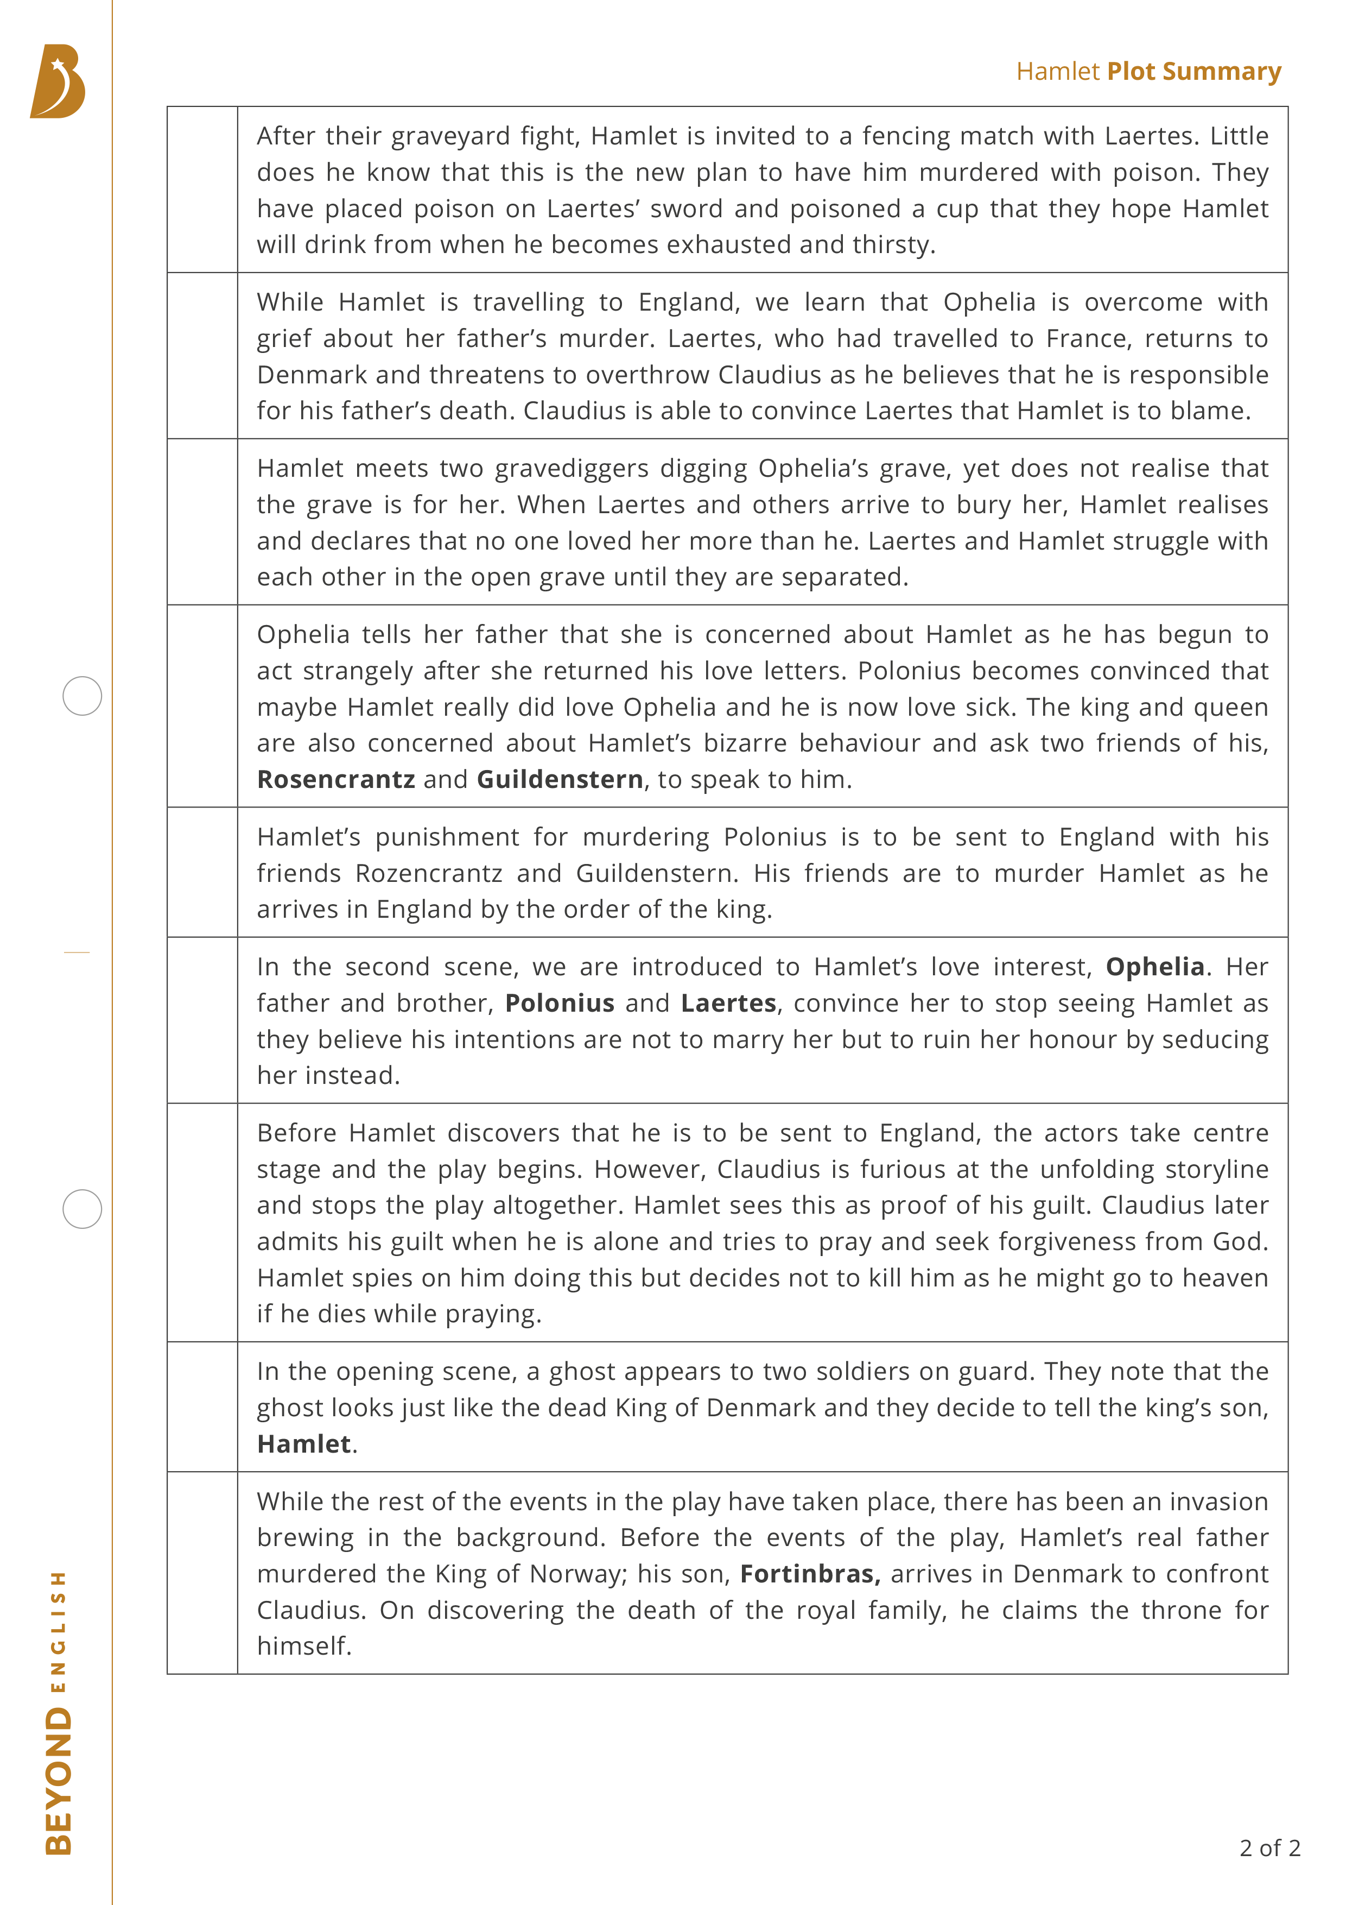
The Plot
Using the Plot Sort worksheet, number the boxes to order the events chronologically. The sentence openers might help to give you some clues.
You may want to complete the activity in pencil in case you need to make any changes.

Slide 6
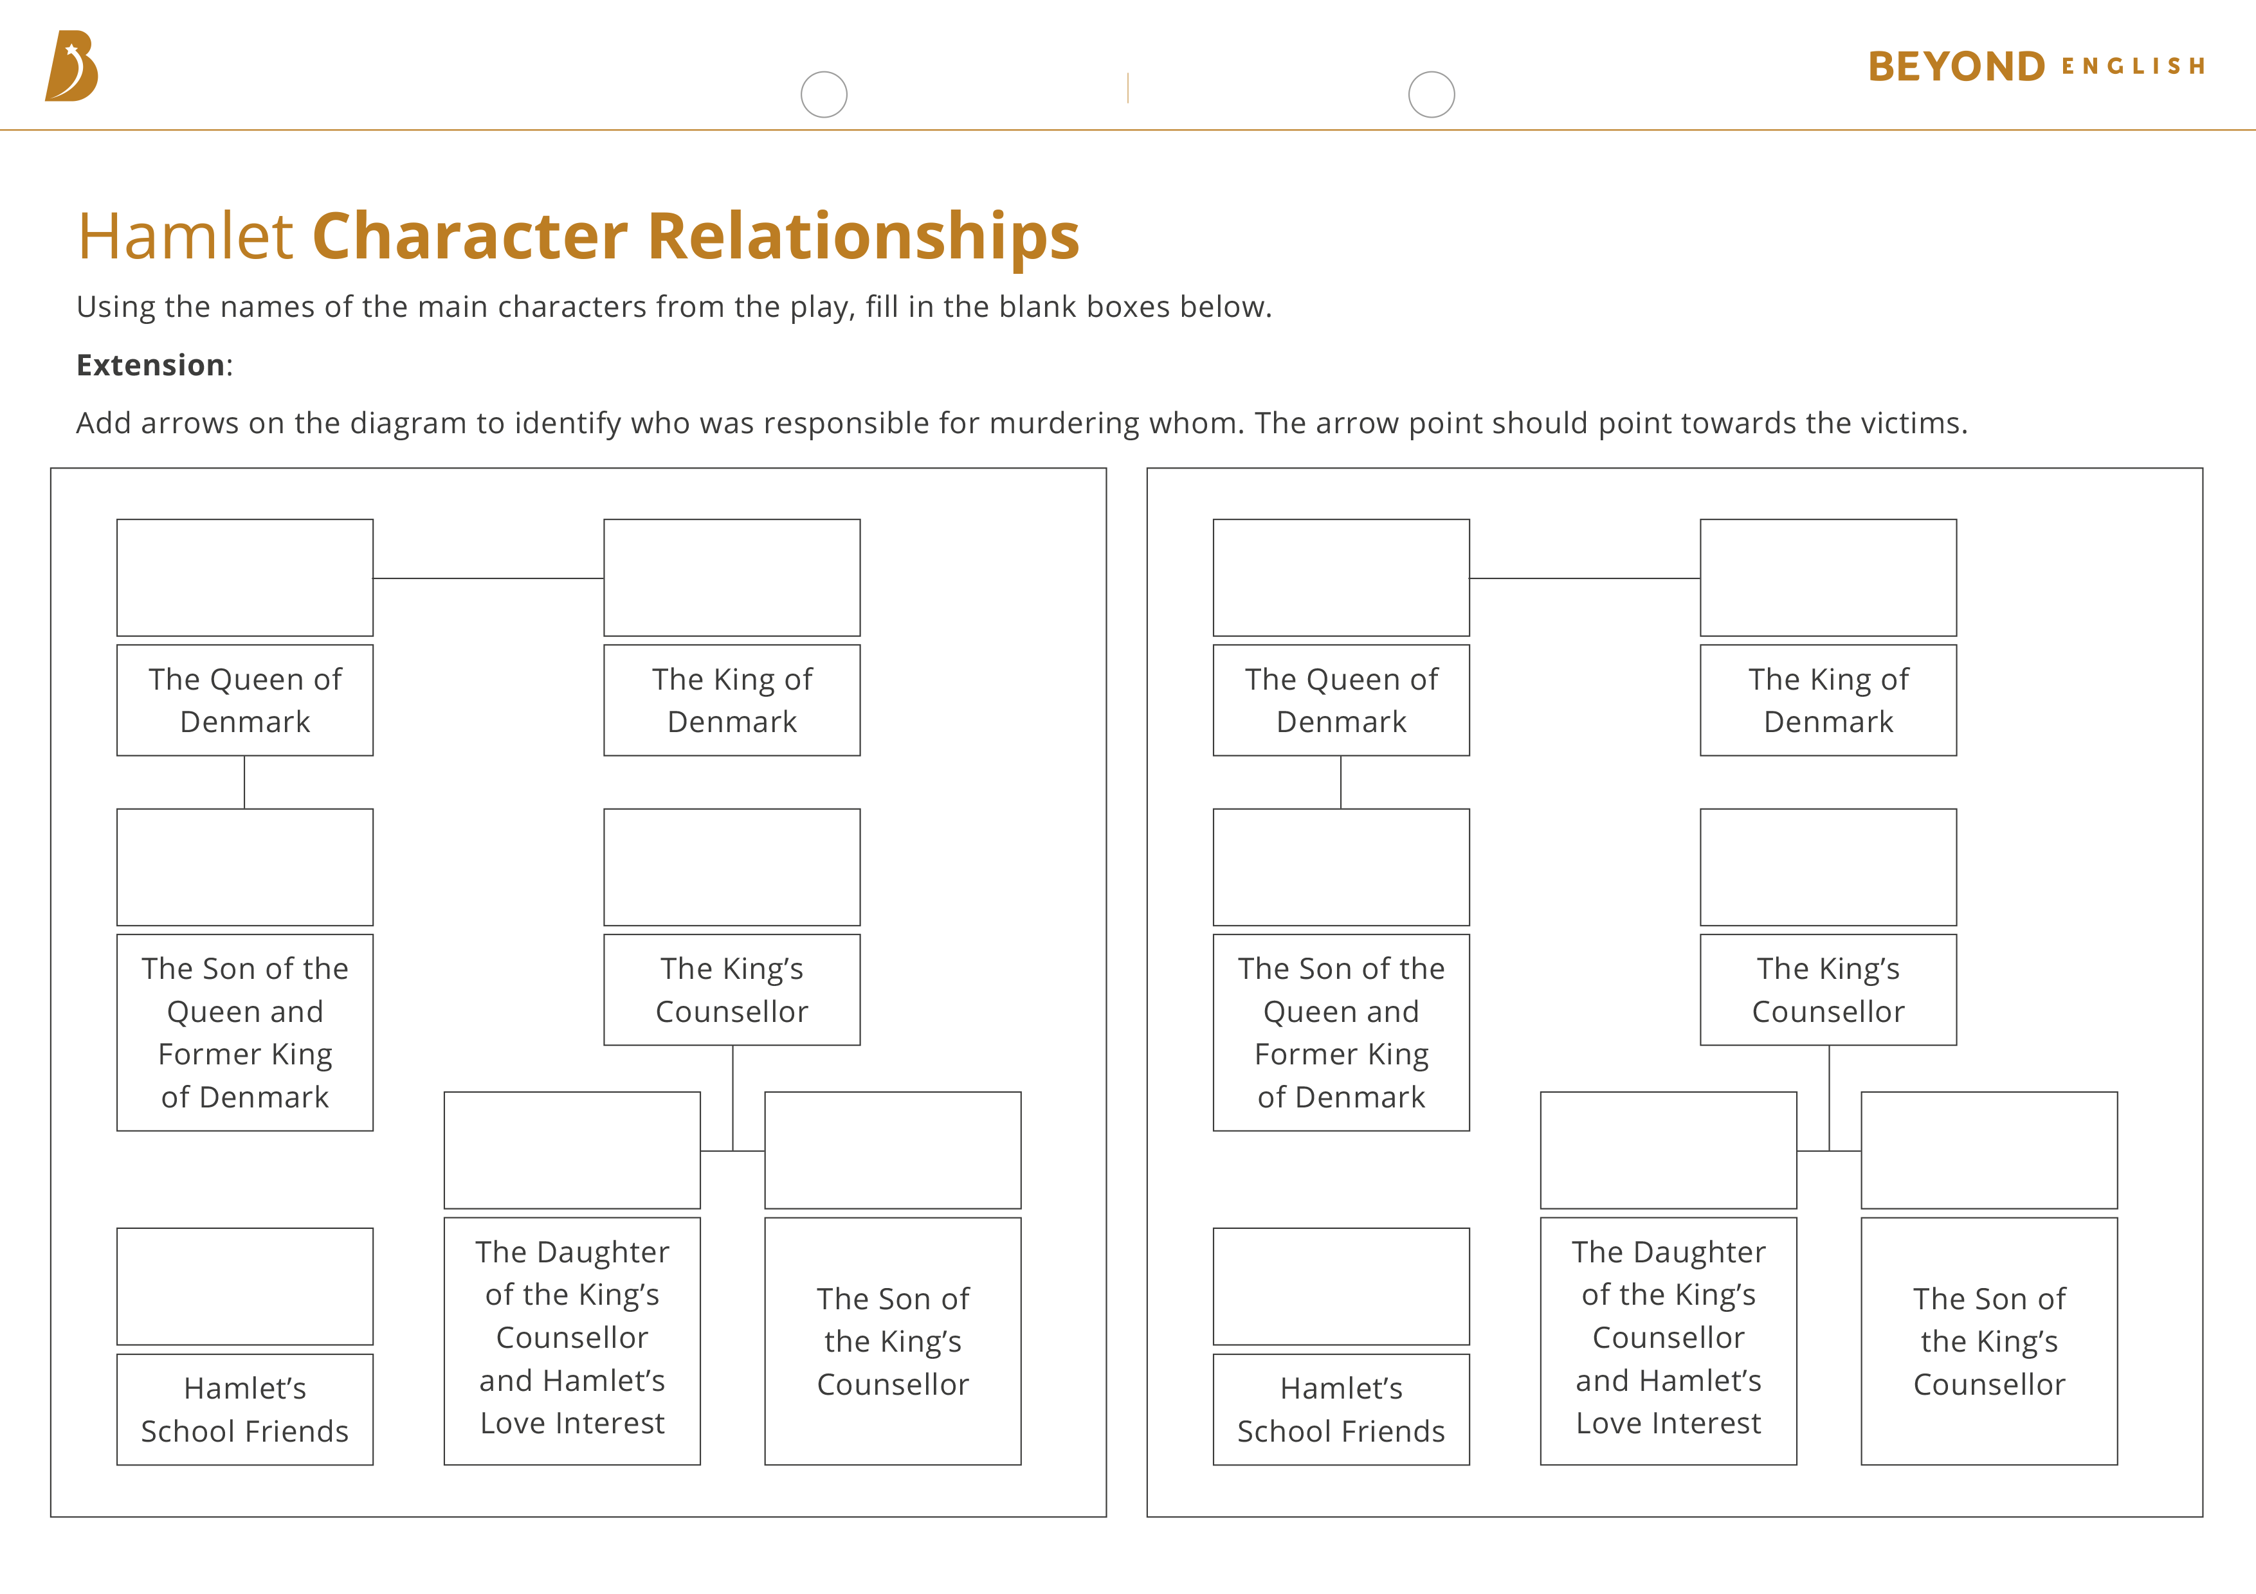
Character Relationships
Now that you have an understanding of the play’s plot, it is important to ensure that you know who the characters are and how they
relate to each other.
Using the plot summary that you have just completed, can you fill in the blanks of the Character Relationships worksheet?

Slide 7

Reviewing the Rules
Kings are appointed by God.
It is treasonous to speak negatively about the King.
Honour is the most
important value.
Seeking revenge for the death of a parent is an exception to the law.
The mourning period for a King is six months to a year (but do not show grief when you are mourning an ordinary person!)
Below are some keywords that you might find useful in
your response:
Chain of Being Divine
Right of Kings Punishable
Widow Weakness
Remind yourself of the rules that we looked at at the beginning of the lesson. Discuss with a partner which rules are broken, bent or followed within Hamlet, and how?
Why do you think Shakespeare did this?

Slide 8


